Slide 1
AI 620 EMERGING TOPICS IN ARTIFICIAL INTELLIGENCE
Module 4
Information Extraction from Text with Amazon Comprehend

Slide 2
Learning outcomes
Understanding the role of Artificial Intelligence in our workplaces
Performing information extraction with Amazon Comprehend and Amazon Comprehend Medical
Storing and retrieving data in AWS DynamoDB
Building serverless AI applications with AWS services, RESTful APIs, and web user interface
Reusing existing AI service implementations within the reference architecture
Discussing human-in-the-loop interface design in automation solutions

Slide 3
Contact organizer
The contract Organizer application will provide a web user interface for users so that they can upload an image of a business card.
The contact information will be extracted and categorized by the application.
The automatically extracted contact information will then be displayed to the user in the web user interface.
Before saving it to a permanent contact store, the user can review and correct the information.

Slide 4
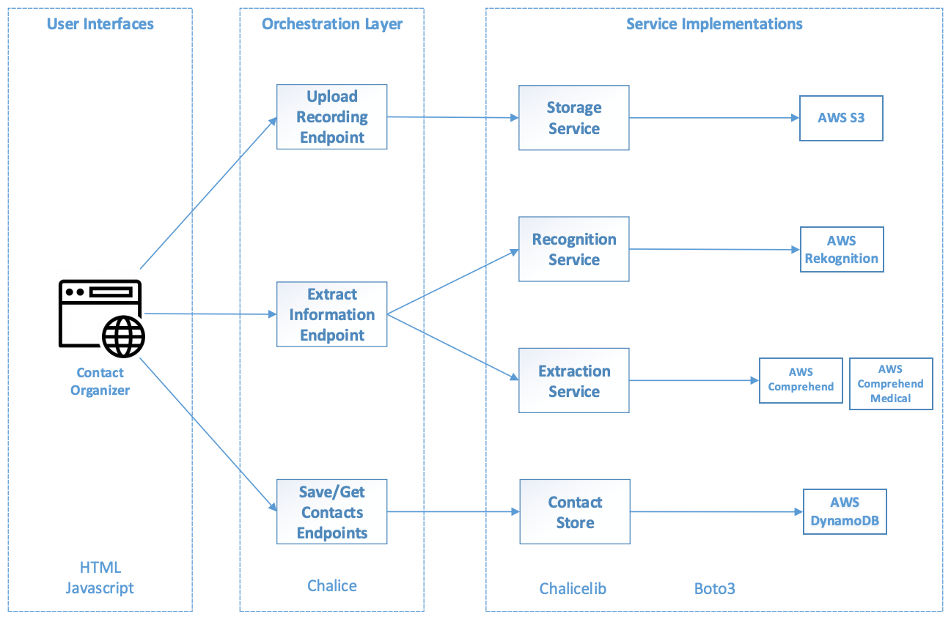
Contact Organizer architecture

Slide 5
3 RESTFUL ENDPOINTS
Upload Recording Endpoint will delegate the image upload to our Storage Service.
Extract Information Endpoint will use the Recognition Service and Extraction Service:
The Recognition Service is reused from Chapter 3, Detecting and Translating Text with Amazon Rekognition and Translate, when we looked at the Pictorial Translator project.
The Extraction Service will use both Amazon Comprehend and Amazon Comprehend Medical to extract and categorize the diverse contact information such as name, address, and phone number.
Save/Get Contacts Endpoints will write to/read from the Contact Store, which is backed by the AWS DynamoDB NoSQL database.

Slide 6
Reusable services
In Contact Organizer, there are several opportunities for us to reuse components we already implemented in previous projects.
In the orchestration layer, we can reuse the Upload Recording Endpoint.
In the service implementation layer, we can reuse the Storage and Recognition services.

Slide 7
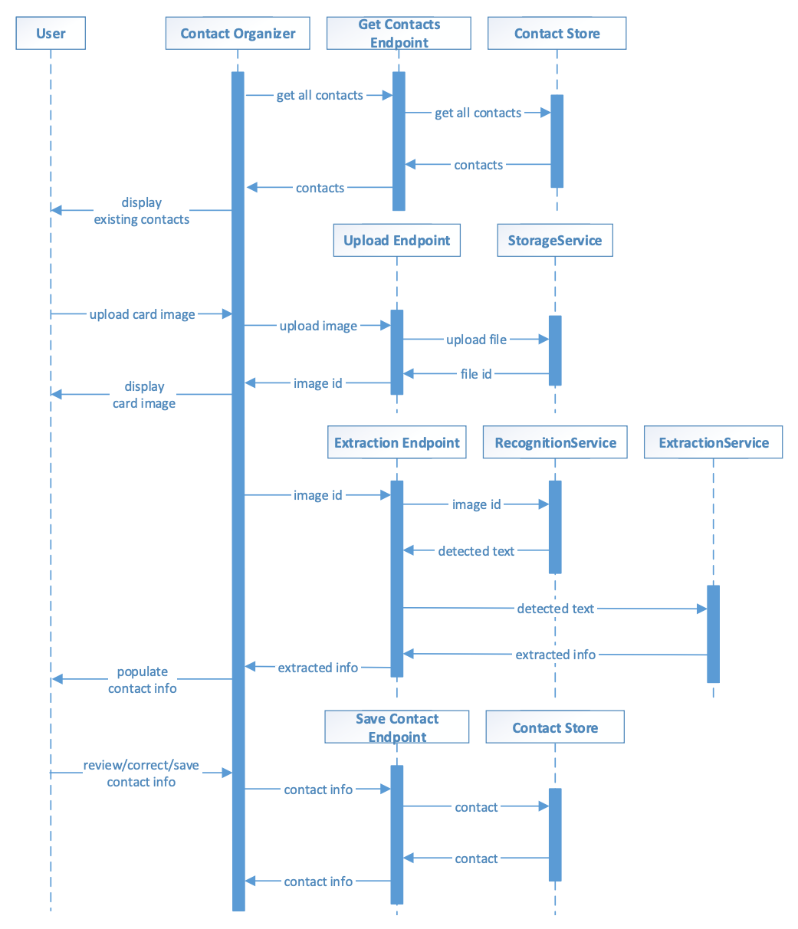
Component interactions in contact organizer

Slide 8
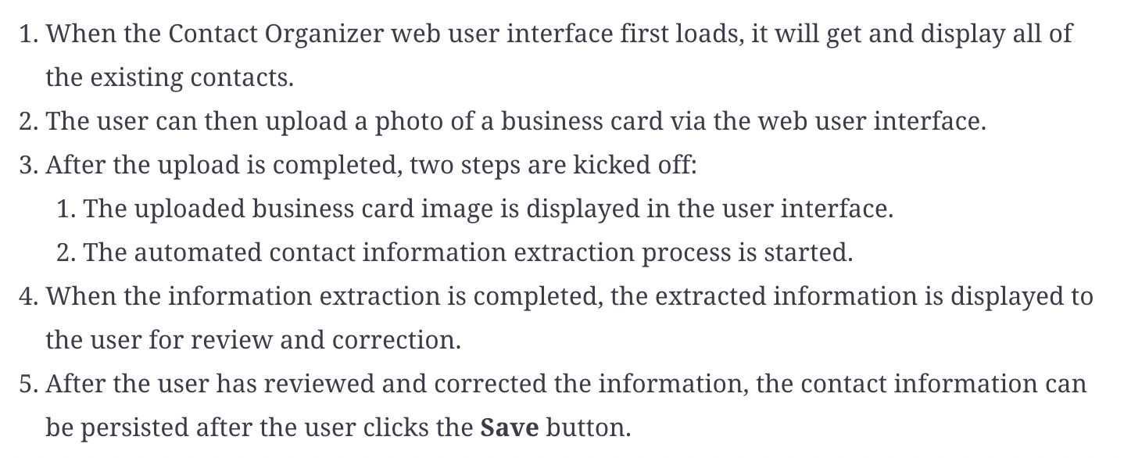
User's perspective process

Slide 9
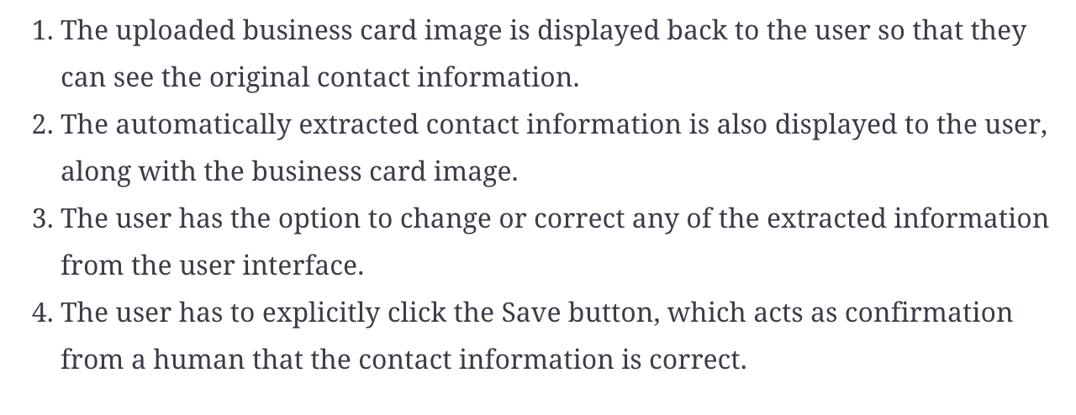
User interface design

Slide 10
Design thought
The human-in-the-loop user interface should not just be an afterthought in an intelligence-enabled solution.
Our rule of thumb for evaluating the design of such interfaces is that the solution should be fully functional, even if the AI capabilities are not present alongside the user interface.

Slide 11
Implementing the project
PE04-1
Setting up the project structure
Follow textbook page169 step 1 to 6
PE04-2 Implementing services
2.1 Recognition Service – text detection (Same as PE02)
2.2 Extraction Service – contact information extraction
2.3 Contact Store – save and retrieve contacts
2.4 Storage Service – uploading and retrieving a file (Same as PE02)

Slide 12
About 2.2 Extraction Service – contact information extraction
We are going to leverage Amazon Comprehend to extract the contact information from the text that's detected on the business cards.
Amazon Comprehend Medical extracted much of the same information as its non-medical counterpart. In addition, it extracted the job title (PROFESSION), the phone number (PHONE_OR_FAX), and the email (EMAIL). The extracted address (ADDRESS) also seems more accurate than the non-medical variant. When we combine the results from both variants of the Comprehend service, we are able to extract the contact information on typical business cards.

Slide 13
About 2.3 Contact Store – save and retrieve contacts
After the user saves the contact information in the Contact Organizer, they should be able to retrieve this information. Retrieving data requires data persistence.
In Contact Organizer, we will be leveraging AWS DynamoDB, a highly scalable NoSQL database in the cloud. DynamoDB fits well with our serverless architecture because developers do not need to manage database servers. Instead, developers can create tables that scale with demand automatically. We will be storing and retrieving contact information using a DynamoDB table.

Slide 14
IMPLEMENTING THE PROJECT
PE04-3 Implementing RESTful endpoints
3.1 Extract Image Information endpoint
3.2 Save contact and get all contacts endpoint
3.3 Upload image endpoint (Similar to PE02)
PE04-4 Implementing the web user interface
Index.html + scripts.js
PE04-5 Deploying the Contact Organizer to AWS (Similar to PE02)
DONE!

Slide 15
About 3 implementing restful endpoints
Moving on to the orchestration layer allow us to stitch together the various capabilities we implemented in the services.
The RESTful endpoints provide HTTP access for the user interface layer to access business capabilities.
The orchestration layer should be concise and easy to understand.
RESTful endpoints should only be concerned with orchestrating the services to form a higher-level business logic and handling HTTP protocol specifics.

Slide 16
ABOUT 3 IMPLEMENTING RESTFUL ENDPOINTS
Checking package imports is one way to evaluate whether the orchestration layer or RESTful endpoints are well designed in terms of separation of concerns.
Does the orchestration layer need to import packages from the services?
For example, do the RESTful endpoints import a boto3 that interacts with AWS in our projects?
They shouldn’t
Typically, RESTful endpoints will import sercies implementation (storage_service and recognition_service), programming framework-related packages (chalice), and protocol-related packages (JSON and CGI).

Slide 17
References
Tripuraneni, S., & Song, C. (2019). Hands-On Artificial Intelligence on Amazon Web Services. Packt Publishing. https://learning.oreilly.com/library/view/hands-on-artificial-intelligence/9781789534146/

